Slide 1

Unit-IV

Slide 2

4 Major Versions of Python
“Python” or “CPython” is written in C/C++
Version 2.7 came out in mid-2010
Version 3.1.2 came out in early 2010
“Jython” is written in Java for the JVM
“IronPython” is written in C# for the .Net environment

Slide 3
Contd…
Created in 1989 by Guido Van Rossum
Python 1.0 released in 1994
Python 2.0 released in 2000
Python 3.0 released in 2008
Python 2.7 is the recommended version
3.0 adoption will take a few years

Slide 4
Development Environments IDE
PyDev with Eclipse
Komodo
Emacs
Vim
TextMate
Gedit
Idle
PIDA (Linux)(VIM Based)
NotePad++ (Windows) 10.Pycharm

Slide 5
Web Frameworks
Django
Flask
Pylons
TurboGears
Zope
Grok

Slide 6
Introduction
Multi-purpose (Web, GUI, Scripting, etc.)
Object Oriented
Interpreted
Strongly typed and Dynamically typed
Focus on readability and productivity

Slide 7
Python features
no compiling or linking
rapid development cycle
no type declarations
simpler, shorter, more flexible
automatic memory management
garbage collection
high-level data types and operations

Slide 8
Contd..
fast development
object-oriented programming
code structuring and reuse, C++
embedding and extending in C
mixed language systems
classes, modules, exceptions,multithreading
"programming-in-the-large" support

Slide 9
Uses of Python
shell tools
system admin tools, command line programs
extension-language work
rapid prototyping and development
language-based modules
instead of special-purpose parsers
graphical user interfaces
database access
distributed programming
Internet scripting
10

Slide 10
Why Python
Python is a general purpose, high level object oriented language.
It is an interpreted language.
It is an open source and free language.
It is a dynamic programming language.

Slide 11
Before writing a program…….
$ where is python
python: /usr/bin/python /usr/bin/python2.7 /etc/python /etc/python2.7 /usr/lib/python2.6 /usr/lib/python2.7 /usr/local/lib/python2.7 /usr/include/python2.6 /usr/include/python2.7 /usr/share/python /usr/share/man/man1/python.1.gz

Slide 12
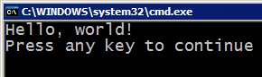
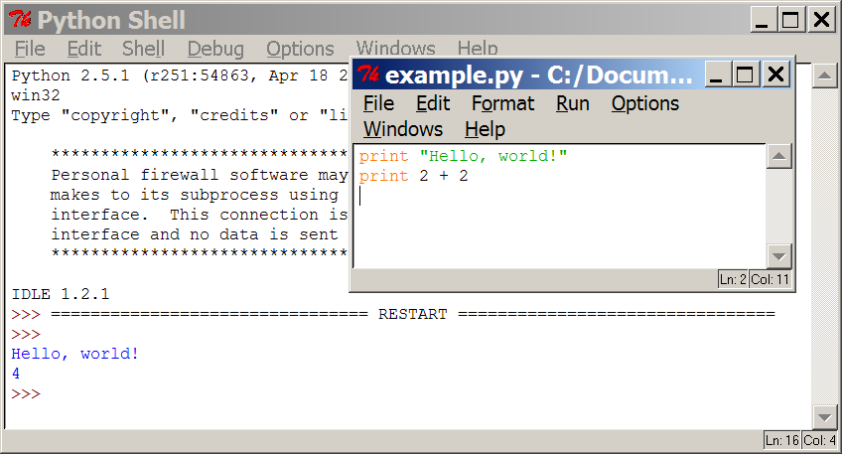
Programming basics
Code or source code: The sequence of instructions in a program.
Syntax: The set of legal structures and commands that can be used in a particular programming language.
Output: The messages printed to the user by a program.
Console: The text box onto which output is printed.
Some source code editors pop up the console as an external window, and others contain their own console window.

Slide 13




Compiling and Interpreting
Many languages require to compile (translate) program into a form that the machine understands.
compile
execute
source code
Hello.java
byte code
Hello.class
output
Python is instead directly interpreted into machine instructions.
interpret
source code
Hello.py
output

Slide 14
Python Editors
Onlinegdb(Online)
Jupyter(Online)
Anaconda
Python IDE

Slide 15
First Python Program
print ("Hello, World!“)
comp197@comp197:~/Desktop$ python ass.py
Hello world

Slide 16
Using variables
i = 5
print(i)
i = i + 1
print(i)
s = “””This is a multi-line string.
This is the second line.”””
print(s)

Slide 17
Output
$ python var.py
5
6
This is a multi-line string.
This is the second line.

Slide 18
Comments in Python
#!/usr/bin/python
# First comment
print "Hello, Python!"; # second comment

Slide 19
Indentation-Most Important
i = 5
print('Value is ', i) # Error! Notice a single space at the start of the line
print('I repeat, the value is ', i)

Slide 20
Using Expressions
#!/usr/bin/python
# Filename: expression.py
length = 5
breadth = 2
area = length * breadth
print('Area is', area)
print('Perimeter is', 2 * (length + breadth))

Slide 21
Output
$ python expression.py
Area is 10
Perimeter is 14

Slide 22
Math commands
Python has useful commands for performing calculations.
To use math commands, you must write the following at the top of your Python program:
from math import *
Command name | Description
abs(value) | absolute value
ceil(value) | rounds up
cos(value) | cosine, in radians
floor(value) | rounds down
log(value) | logarithm, base e
log10(value) | logarithm, base 10
max(value1, value2) | larger of two values
min(value1, value2) | smaller of two values
round(value) | nearest whole number
sin(value) | sine, in radians
sqrt(value) | square root

Slide 23
Variables
variable: A named piece of memory that can store a value.
Compute an expression's result,
store that result into a variable,
and use that variable later in the program.
assignment statement: Stores a value into a variable.
Syntax: name = value
Examples: x = 5 gpa = 3.14
x 5 gpa 3.14
A variable that has been given a value can be used in expressions.
x + 4 is 9
Exercise: Evaluate the multiplication of three numbers for a given a, b, and c.

Slide 24
Variables
Can contain letters, numbers, and underscores
Must begin with a letter
Cannot be one of the reserved Python keywords:
and, as, assert, break, class, continue, def, del, elif, else, except, exec, finally, for, from, global, if, import, in, is, lambda, not, or, pass, print, raise, return, try, while, with, yield

Slide 25
Variable types
Example types.py:
pi = 3.1415926 message = "Hello, world" i = 2+2 print type(pi) print type(message) print type(i)
Output:
<type 'float'> <type 'str'> <type 'int‘>
Python has incorporated operators like +=,
but ++ (or --) do not work in Python

Slide 26
Variable types
int(), float(), str(), and bool() convert to integer, floating point, string, and boolean (True or False) types, respectively
Example typeconv.py: print 1.0/2.0 print 1/2 print float(1)/float(2) print int(3.1415926) print str(3.1415926) print bool(1) print bool(0)‏
Output: 0.5 0 0.5 3 3.1415926 True False

Slide 27
print (display on console)
print : Produces text output on the console.
Syntax:
print "Message"
print Expression
Prints the given text message or expression value on the console, and moves the cursor down to the next line.
print Item1, Item2, ..., ItemN
Prints several messages and/or expressions on the same line.
Examples:
print "Hello, world!"
age = 45
print "You have", 65 - age, "years until retirement“
Output:
Hello, world!
You have 20 years until retirement

Slide 28
input (read)
input : Reads a number from user input.
You can assign (store) the result of input into a variable.
Example:
age = input("How old are you? ")
i = raw_input("Enter a math expression: ") print "Your age is", age
print "You have", 65 - age, "years until retirement“
Output:
How old are you? 53
Enter a math expression: 2+5
Your age is 53
You have 12 years until retirement
Exercise: Write a Python program to accept the marks of three subjects from user and display its average.

Slide 29
Basic operations
Assignment:
– size = 40
– a = b
Numbers
integer, float
complex numbers: 1j+3, abs(z)
Strings
'hello world', 'it\'s hot'
"bye world"
= c = 3

Slide 30
String operations
concatenate with + or neighbours
word = 'Help' + x
word = 'Help' 'a'
subscripting of strings
– 'Hello'[2] → 'l'
– slice: 'Hello'[1:2] → 'el'
word[-1] → last character
len(word) → 5
– immutable: cannot assign to subscript

Slide 31
Numbers: Integers
Integer – the equivalent of a C long
Long Integer – an unbounded integer value.
>>> 132224
132224
>>> 132323 ** 2 17509376329L
>>>

Slide 32
Numbers: Floating Point
int(x) converts x to an integer
float(x) converts x to a floating point
The interpreter shows a lot of digits
>>> 1.23232
1.2323200000000001
>>> print 1.23232
1.23232
>>> 1.3E7 13000000.0
>>> int(2.0) 2
>>> float(2) 2.0

Slide 33
Numbers: Complex
Built into Python
Same operations are supported as integer and float
>>> x = 3 + 2j
>>> y = -1j
>>> x + y (3+1j)
>>> x * y (2-3j)

Slide 34
Numbers are immutable
x ^{4.5}
y
>>> x = 4.5
>>> y = x
>>> y += 3
x y
4.5
7.5
>>> x 4.5
>>> y 7.5

Slide 35
String Literals
Strings are immutable
There is no char type like in C++ or Java
• + is overloaded to do concatenation
>>> x = 'hello'
>>> x = x + ' there'
>>> x
'hello there'

Slide 36
String Literals: Many Kinds
Can use single or double quotes, and three double quotes for a multi-line string
>>> 'I am a string' 'I am a string'
>>> "So am I!"
'So am I!'
>>> s = """And me too! though I am much longer than the others :)"""
'And me too!\nthough I am much longer\nthan the others :)‘
>>> print s And me too!
though I am much longer
than the others :)‘

Slide 37
Substrings and Methods
len(String) – returns the number of characters in the String
>>> s = '012345'
>>> s[3] '3'
>>> s[1:4] '123'
>>> s[2:] '2345'
>>> s[:4] '0123'
>>> s[-2] '4'
str(Object) – returns a String representation of the Object
>>> len(x) 6
>>> str(10.3) '10.3'

Slide 38
String Formatting
Similar to C’s printf
<formatted string> % <elements to insert>
Can usually just use %s for everything, it will convert the object to its String representation.
>>> "One, %d, three" % 2 'One, 2, three'
>>> "%d, two, %s" % (1,3)
'1, two, 3'
>>> "%s two %s" % (1, 'three') '1 two three'
>>>

Slide 39
Do nothing
pass does nothing
syntactic filler
while 1: pass

Slide 40
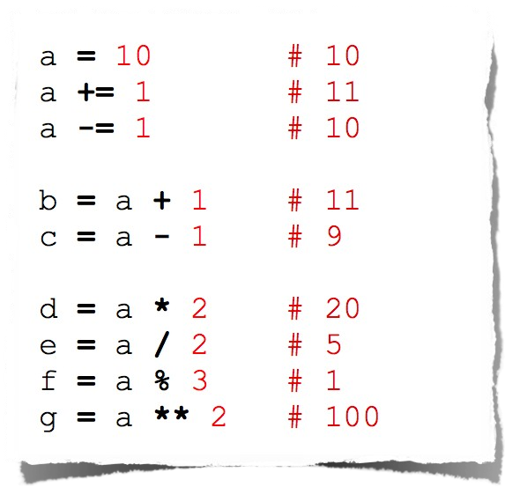
Operators
Arithmetic

Slide 41
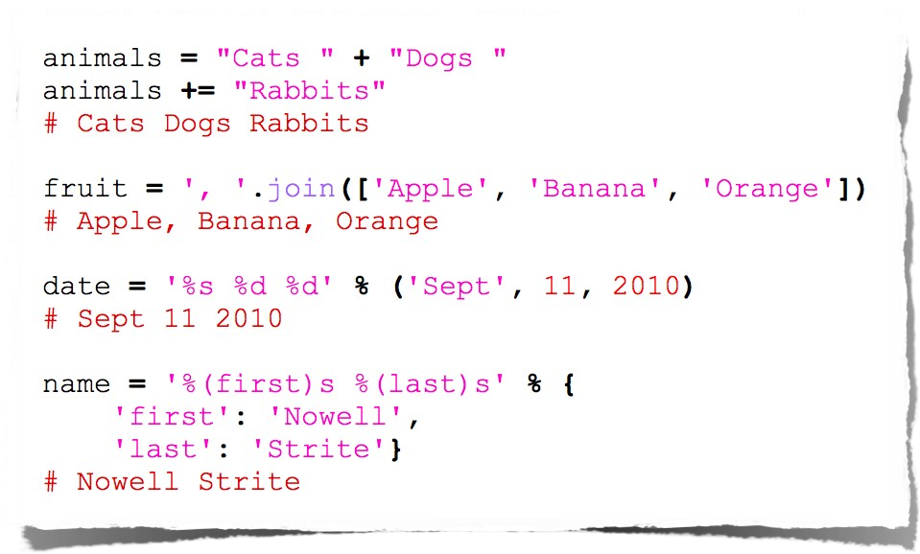
String Manipulation

Slide 42
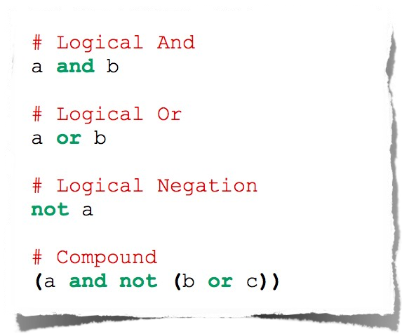
Logical Comparison

Slide 43
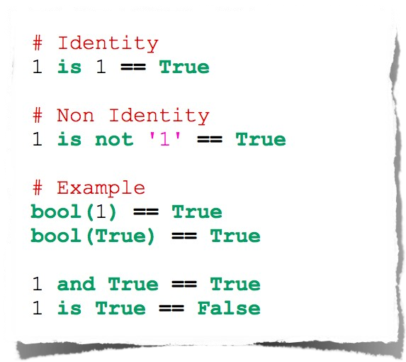
Identity Comparison

Slide 44
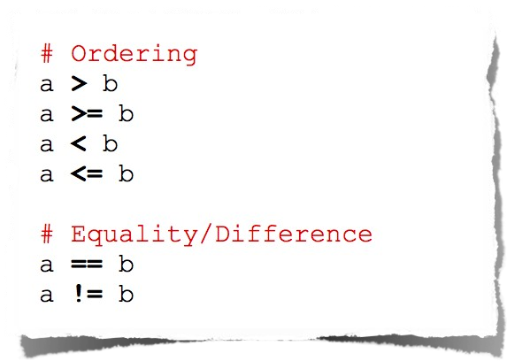
Arithmetic Comparison

Slide 45
What is a List in Python?
A list is a data structure that’s built into Python and holds a collection of items. Lists have a number of important characteristics:
List items are enclosed in square brackets, like this [item1, item2, item3].
Lists are ordered – i.e. the items in the list appear in a specific order. This enables us to use an index to access to any item.
Lists are mutable, which means you can add or remove items after a list’s creation.
List elements do not need to be unique. Item duplication is possible, as each element has its own distinct place and can be accessed separately through the index.
Elements can be of different data types: you can combine strings, integers, and objects in the same list.

Slide 46
Lists in Python
If you have a list of items (a list of car names, for example), storing the cars in single variables could look like this:
car1 = "Ford" car2 = "Volvo" car3 = "BMW"
cars = ["Ford", "Volvo", "BMW"]

Slide 47
Printing list
print(cars)
Or
for x in cars: print(x)
for i in range(1,4):
print(cars[i])

Slide 48
Built in Functions of list
a=[1,2,3,4,5]
d=[2,2.3,4.5,6.7]
Print(max(a))
Print(min(a))
Print(sorted(a))
len(a)
a.pop()
a.remove(3)
del a[2]

Slide 49
Accepting list from user
n=int(input("enter size"))
a=[1,2,3,4,5]
d=[2,2.3,4.5,6.7]
for i in range(0,n):
x=int(input("enter a number"))
#a.append(x)
a[i]=x

Slide 50
Problems on list
Calculate sum of n elements
Adding element in list at particular position
Printing list in reverse order
Remove duplicate elements from list

Slide 51
Python Data Types: Dictionary
course ={'PPL':'Jayshree','DS':'Priyanka','COA':'Shamla'}
print("dictionary :", course)
print(course.values())
print(course.keys())
print(course['DS']) # acess an element
course["OOP"]="Shreya"
print("dictionary :", course)
print("length dictionary : ",len(course))
course["OOP"]="Object Prog" # change value
print("dictionary :", course)
del course["OOP"]
print("dictionary :", course)

Slide 52
List Operations
There are various operations that we can perform on Lists.
1. Update elements
There are several ways you can add elements to a list.
orderItem=[1, "Sam", "Computer", 75.50, True]
Print(orderItem)
orderItem[2]="Laptop“ #addition of
Print(orderItem)
2. Adding item at the desired location
orderItem=[1, "Sam", "Computer", 75.50, True]
OrderItem.insert(3, Personal) # adding element 100 at the fourth location

Slide 53
3. #Adding element at the end of the list
orderItem=[1, "Sam", "Computer", 75.50, True]
orderItem.append(‘abc’)
4. #Adding several elements at the end of list
orderItem=[1, "Sam", "Computer", 75.50, True]
orderItem.extend([‘MIT’,2020])
Delete elements
# Deleting 2nd element
orderItem=[1, "Sam", "Computer", 75.50, True]
del orderItem[1]
# Deleting elements from 3rd to 4th
orderItem=[1, "Sam", "Computer", 75.50, True]
del orderItem[2:3]
# Deleting the whole list
orderItem=[1, "Sam", "Computer", 75.50, True]
del orderItem
#remove(item): Removes specified item from list.
orderItem=[1, "Sam", "Computer", 75.50, True]
orderItem.remove(‘C’)
#pop(index): Removes the element from the given index.
# Deleting 2nd element
orderItem=[1, "Sam", "Computer", 75.50, True]
orderItem.pop(1)
#Deleting all the elements
orderItem=[1, "Sam", "Computer", 75.50, True]
orderItem.clear()

Slide 54
# Find the sum of ‘n’ numbers
n = input("Enter the number of elements to be calculated for finding the sum :")
n = int (n)
sum = 0
for num in range(0,n+1,1):
sum = sum + num
print("SUM of first ", n, "numbers is: ", sum )
range (start, stop, step)
It takes three arguments. Out of the three 2 arguments are optional. I.e., start and step are the optional arguments.
A start argument is a starting number of the sequence. i.e., lower limit. By default, it starts with 0 if not specified.
A stop argument is an upper limit. i.e., generate numbers up to this number, The range() doesn’t include this number in the result.
The step is a difference between each number in the result. The default value of the step is 1 if not specified.

Slide 55
Python Arrays
Python does not have built-in support for Arrays, but Python Lists can be used instead.
Arrays are used to store multiple values in one single variable
Array Methods
Python has a set of built-in methods that you can use on lists/arrays.
Method | Description
append() | Adds an element at the end of the list
clear() | Removes all the elements from the list
copy() | Returns a copy of the list
count() | Returns the number of elements with the specified value
extend() | Add the elements of a list (or any iterable), to the end of the current list
index() | Returns the index of the first element with the specified value
insert() | Adds an element at the specified position
pop() | Removes the element at the specified position
remove() | Removes the first item with the specified value
reverse() | Reverses the order of the list
sort() | Sorts the list

Slide 56
#Find the average of elements of an array
n = int(input("enter the size of array :"))
arr = [ ]
sum=0
for i in range(n):
x = int(input("enter element: "))
arr.append(x)
sum=sum+arr[i]
print(“Entered array is :", arr, " and Average of elements is ", float(round((sum/n),2)))

Slide 57
Python Data Types: Tuples
In Python, a tuple is similar to List except that the objects in tuple are immutable which means we cannot change the elements of a tuple once assigned. On the other hand, we can change the elements of a list.
Tuple vs List
1. The elements of a list are mutable whereas the elements of a tuple are immutable. 2. When we do not want to change the data over time, the tuple is a preferred data type whereas when we need to change the data in future, list would be a wise option. 3. Iterating over the elements of a tuple is faster compared to iterating over a list. 4. Elements of a tuple are enclosed in parenthesis whereas the elements of list are enclosed in square bracket.

Slide 58
How to create a tuple in Python
A tuple is another sequence data type that is similar to the list.
The main differences between lists and tuples are: Lists are enclosed in brackets ( [ ] ) and their elements and size can be changed, while tuples are enclosed in parentheses ( ( ) ) and cannot be updated.
TupSub = ( ‘DMTA', ‘NLP’ , ‘CS121’ )
TupMob = (‘Iphone6’, ‘Sony‘, ’Appo’)
print (TupSub) # Prints complete list
print (TupSub[0]) # Prints first element of the list
print (TupSub[1:3]) # Prints elements starting from 2nd till 3rd
print (TupSub[2:]) # Prints elements starting from 3rd element
print (TupMob * 2 ) # Prints list two times
print (TupSub + TupMob) # Prints concatenated lists

Slide 59
Accessing tuple elements using positive indexes
Negative indexes in tuples
Similar to list and strings we can use negative indexes to access the tuple elements from the end.
-1 to access last element, -2 to access second last and so on.
my_data = (1, 2, "Kevin", 8.9)
# accessing last element
# prints 8.9
print(my_data[-1])
# prints 2
print(my_data[-3])
# tuple of strings
my_data = ("hi", "hello", "bye")
# displaying all elements
print(my_data)
# accessing first element
# prints "hi"
print(my_data[0])
# accessing third element
# prints "bye"
print(my_data[2])

Slide 60
Remove Items
Note: You cannot remove items in a tuple.
Tuples are unchangeable, so you cannot remove items from it, but you can delete the tuple completely:
Example
The del keyword can delete the tuple completely:
thistuple = ("apple", "banana", "cherry")
del thistuple
print(thistuple) #this will raise an error because the tuple no longer exists

Slide 61
Built-in Tuple Methods
len(): Returns the number of elements in the tuple.
t1=(12,45,43,8,35)
len(t1)
max(): If the tuple contains numbers, the heighest number will be returned. If the tuple contains strings, the one that comes last in alphabetical order will be returned.
t1=(12, 45, 43, 8, 35)
max(t1)
t2=('python', 'java', 'C++')
max(t2)
min(): If the tuple contains numbers, the lowest number will be returned. If the tuple contains strings, the one that comes first in alphabetical order will be returned.
t1=(12,45,43,8,35)
min(t1)

Slide 62
Built-In Methods
BUILT-IN FUNCTION | DESCRIPTION
all() | Returns true if all element are true or if tuple is empty
any() | return true if any element of the tuple is true. if tuple is empty, return false
len() | Returns length of the tuple or size of the tuple
enumerate() | Returns enumerate object of tuple
max() | return maximum element of given tuple
min() | return minimum element of given tuple
sum() | Sums up the numbers in the tuple
sorted() | input elements in the tuple and return a new sorted list
tuple() | Convert an iterable to a tuple.

Slide 63
Immutable and Mutable
TupSub = ( ‘DMTA', ‘NLP’ , ‘CS121’ )
Code = [123, 124, 125]
TupSub[2] = ‘Compiler’ # Invalid syntax with tuple
Code[2] = 1000 # Valid syntax with list

Slide 64
Python Data Types: Dictionary
Python's dictionaries are kind of hash table type. They work like associative arrays or hashes found in Perl and consist of key-value pairs
Dictionaries are enclosed by curly braces ({ }) and values can be assigned and accessed using square braces ([])
cardict = { "brand": "Ford", "model": "Mustang", "year": 1964 } print(cardict)

Slide 65
Accessing Items
You can access the items of a dictionary by referring to its key name, inside square brackets:
Example
Get the value of the "model" key:
x = cardict["model"]
There is also a method called get() that will give you the same result:
Example
Get the value of the "model" key:
x = cardict.get("model")

Slide 66
Change Values
You can change the value of a specific item by referring to its key name:
Example
Change the "year" to 2018:
cardict = {
"brand": "Ford",
"model": "Mustang",
"year": 1964
}
cardict["year"] = 2018
Loop Through a Dictionary
You can loop through a dictionary by using a for loop.
When looping through a dictionary, the return value are the keys of the dictionary, but there are methods to return the values as well.
Example
Print all key names in the dictionary, one by one:
for x in cardict:
print(x)

Slide 67
Print all values in the dictionary, one by one:
for x in cardict:
print(cardict[x])
You can also use the values() method to return values of a dictionary:
for x in cardict.values():
print(x)
Loop through both keys and values, by using the items() method:
for x, y in cardict.items():
print(x, y)

Slide 68
Python Dictionary clear() Method
Example
Remove all elements from the car list:
car = {
"brand": "Ford",
"model": "Mustang",
"year": 1964
}
car.clear()
print(car)
Python Dictionary copy() Method
Example
Copy the car dictionary:
car = {
"brand": "Ford",
"model": "Mustang",
"year": 1964
}
x = car.copy()
print(x)

Slide 69
Python Dictionary fromkeys() Method
Example
Create a dictionary with 3 keys, all with the value 0:
x = ('key1', 'key2', 'key3')
y = 0
thisdict = dict.fromkeys(x, y)
print(thisdict)
Python Dictionary items() Method
Example
Return the dictionary's key-value pairs:
car = {
"brand": "Ford",
"model": "Mustang",
"year": 1964
}
x = car.items()
print(x)

Slide 70
Python Dictionary keys() Method
Example
Return the keys:
car = {
"brand": "Ford",
"model": "Mustang",
"year": 1964
}
x = car.keys()
print(x)
Python Dictionary pop() Method
Example
Remove "model" from the dictionary:
car = {
"brand": "Ford",
"model": "Mustang",
"year": 1964
}
car.pop("model")
print(car)
car.popitem() #popitem() Method Remove the last item from the dictionary
print(car)

Slide 71
Python Data Types: Dictionary
course ={'PPL':'Jayshree','DS':'Priyanka','COA':'Shamla'}
print("dictionary :", course)
print(course.values())
print(course.keys())
print(course['DS']) # acess an element
course["OOP"]="Shreya"
print("dictionary :", course)
print("length dictionary : ",len(course))
course["OOP"]="Object Prog" # change value
print("dictionary :", course)
del course["OOP"]
print("dictionary :", course)

Slide 72
Sets
A set is a collection which is unordered and unindexed. In Python sets are written with curly brackets.
thisset = {"apple", "banana", "cherry"} print(thisset)

Slide 73
Sets
You cannot access items in a set by referring to an index, since sets are unordered the items has no index.
thisset = {"apple", "banana", "cherry"} for x in thisset: print(x)

Slide 74
Sets
thisset = {"apple", "banana", "cherry"} print("banana" in thisset)
thisset = {"apple", "banana", "cherry"} thisset.add("orange") print(thisset)

Slide 75
thisset = {"apple", "banana", "cherry"} thisset.update(["orange", "mango", "grapes"]) print(thisset)

Slide 76
thisset = {"apple", "banana", "cherry"} thisset.remove("banana") print(thisset)

Slide 77
thisset = {"apple", "banana", "cherry"} thisset.discard("banana") print(thisset)

Slide 78
set1 = {"a", "b" , "c"} set2 = {1, 2, 3} set3 = set1.union(set2) print(set3)
Intersection()
Difference()

Slide 79
set1 = {"a", "b" , "c"} set2 = {1, 2, 3} set1.update(set2) print(set1)

Slide 80
set1 = set()
print("Intial blank Set: ")
print(set1)
# Adding element and tuple to the Set
set1.add(8)
set1.add(9)
set1.add((6,7))
print("\nSet after Addition of Three elements: ")
print(set1)
# Adding elements to the Set
# using Iterator
for i in range(1, 6):
set1.add(i)
print("\nSet after Addition of elements from 1-5: ")
print(set1)

Slide 81
Python frozenset()
The frozenset() function returns an immutable frozenset object initialized with elements from the given iterable.
Frozen set is just an immutable version of a Python set object. While elements of a set can be modified at any time, elements of the frozen set remain the same after creation.
Due to this, frozen sets can be used as keys in Dictionary or as elements of another set. But like sets, it is not ordered (the elements can be set at any index).
The syntax of frozenset() function is:
frozenset([iterable])

Slide 82
frozenset() Parameters
The frozenset() function takes a single parameter:
iterable (Optional) - the iterable which contains elements to initialize the frozenset with.
Iterable can be set, dictionary, tuple, etc.
Return value from frozenset()
The frozenset() function returns an immutable frozenset initialized with elements from the given iterable.
If no parameters are passed, it returns an empty frozenset.

Slide 83
Example 1: Working of Python frozenset()
# tuple of vowels
vowels = ('a', 'e', 'i', 'o', 'u')
fSet = frozenset(vowels)
print('The frozen set is:', fSet)
print('The empty frozen set is:', frozenset())
# frozensets are immutable
fSet.add('v')
Output
The frozen set is: frozenset({'a', 'o', 'u', 'i', 'e'})
The empty frozen set is: frozenset()
Traceback (most recent call last):
File "<string>, line 8, in <module>
fSet.add('v')
AttributeError: 'frozenset' object has no attribute 'add'

Slide 84
Taking input in Python
Loften have a need to interact with users, either to get data or to provide some sort of result. Most programs today use a dialog box as a way of asking the user to provide some type of input. While Python provides us with two inbuilt functions to read the input from the keyboard.
input ( prompt )
raw_input ( prompt )
input ( ) : This function first takes the input from the user and then evaluates the expression, which means Python automatically identifies whether user entered a string or a number or list. If the input provided is not correct then either syntax error or exception is raised by python. For example –

Slide 85
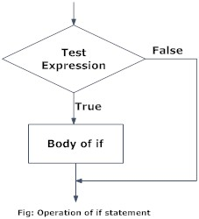
Control Structures: Conditional statement, Looping and Iteration,
Python if...else Statement
In this article, you will learn to create decisions in a Python program using different forms of if..else statement.
Python if Statement Syntax
if test expression:
statement(s)

Slide 86
Example: Python if Statement # If the number is positive, we print an appropriate message
num = 3
if num > 0:
print(num, "is a positive number.")
print("This is always printed.")
num = -1
if num > 0:
print(num, "is a positive number.")
print("This is also always printed.")
When you run the program, the output will be:
Output
3 is a positive number
This is always printed
This is also always printed.

Slide 87
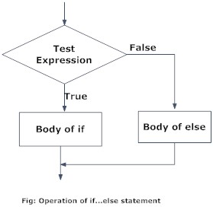
Python if...else Statement
Syntax of if...else
if test expression:
Body of if
else:
Body of else

Slide 88
Example of if...else # Program checks if the number is positive or negative # And displays an appropriate message
num = 3
# Try these two variations as well.
# num = -5
# num = 0
if num >= 0:
print("Positive or Zero")
else:
print("Negative number")
Output
Positive or Zero

Slide 89
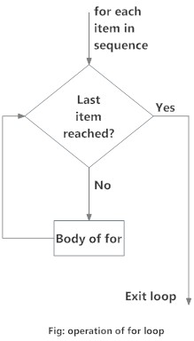
What is for loop in Python?
The for loop in Python is used to iterate over a sequence (list, tuple, string) or other iterable objects. Iterating over a sequence is called traversal.
Syntax of for Loop
for val in sequence:
Body of for

Slide 90
Example: Python for Loop # Program to find the sum of all numbers stored in a list
# List of numbers
numbers = [6, 5, 3, 8, 4, 2, 5, 4, 11]
# variable to store the sum
sum = 0
# iterate over the list
for val in numbers:
sum = sum+val
print("The sum is", sum)
Output:
The sum is 48

Slide 91
The range() function
We can generate a sequence of numbers using range() function. range(10) will generate numbers from 0 to 9 (10 numbers).
We can also define the start, stop and step size as range(start, stop,step_size). step_size defaults to 1 if not provided.
The range object is "lazy" in a sense because it doesn't generate every number that it "contains" when we create it. However, it is not an iterator since it supports in, len and __getitem__ operations.
This function does not store all the values in memory; it would be inefficient. So it remembers the start, stop, step size and generates the next number on the go.
To force this function to output all the items, we can use the function list().

Slide 92
The following example will clarify this.
print(range(10))
print(list(range(10)))
print(list(range(2, 8)))
print(list(range(2, 20, 3)))
Output
range(0, 10)
[0, 1, 2, 3, 4, 5, 6, 7, 8, 9]
[2, 3, 4, 5, 6, 7]
[2, 5, 8, 11, 14, 17]

Slide 93
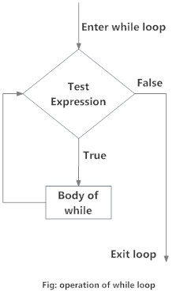
What is while loop in Python?
The while loop in Python is used to iterate over a block of code as long as the test expression (condition) is true.
We generally use this loop when we don't know the number of times to iterate beforehand.
Syntax of while Loop in Python
while test_expression:
Body of while

Slide 94
Example: Python while Loop
# Program to add natural
# numbers up to # sum = 1+2+3+...+n
# To take input from the user,
# n = int(input("Enter n: "))
n = 10
# initialize sum and counter
sum = 0
i = 1
while i <= n:
sum = sum + i
i = i+1 # update counter
# print the sum
print("The sum is", sum)
When you run the program, the output will be:
Enter n: 10
The sum is 55

